Slide 1

Review 2
Project Title:
Batch Number:
Guide Name:
Team Members:
DD – MM - YYYY

Slide 2

Abstract
Introduction: YouTube is a leading platform for content sharing, generating vast amounts of data every day. Objectives: To analyze and visualize YouTube data, providing insights into video performance and audience engagement. Methodology: Data extraction via YouTube API, analysis using Python with libraries like Pandas, Seaborn, and Matplotlib for small datasets, and AWS S3 with Quick Sight for larger datasets. Results: Gained deep insights into video popularity and audience behavior, utilizing both small and large datasets effectively.
DD – MM - YYYY

Slide 3
Motivation
Significance of YouTube Data: With over 2 billion logged-in monthly users, the data is a goldmine for analysis. Opportunities: Understanding patterns in content performance can lead to improved user engagement. Academic Interest: Merging data analysis with cloud services to solve practical problems in social media analytics.
DD – MM - YYYY

Slide 4
Literature Survey (Note: Minimum 10 Research papers must be attached)
S.No. | Title | Published Date | Publishers | Topic | Advantages | Disadvantages
DD – MM - YYYY

Slide 5
Disadvantages OF Existing System
Lack of Real-Time Analysis: Current systems don’t offer real-time insights.
Limited Visualization Tools: Existing methods lack advanced visualizations for large datasets.
High Resource Requirements: Most solutions are computationally heavy, limiting scalability.
DD – MM - YYYY

Slide 6
Proposed System
Real-Time Data Processing: Leveraging streaming data for real-time insights.
Advanced Visualization: Using AWS S3 and QuickSight for scalable and interactive visualizations.
Optimized Data Handling: Utilizing lightweight data analysis libraries like Seaborn and Matplotlib for smaller datasets.
DD – MM - YYYY

Slide 7
Goal
Primary Objective: To analyze and visualize YouTube video data effectively using Python and AWS.
Secondary Objectives:
Identify key factors influencing video views and audience engagement.
Develop dashboards for visualizing data insights.
Offer recommendations for content strategy optimization.
DD – MM - YYYY

Slide 8
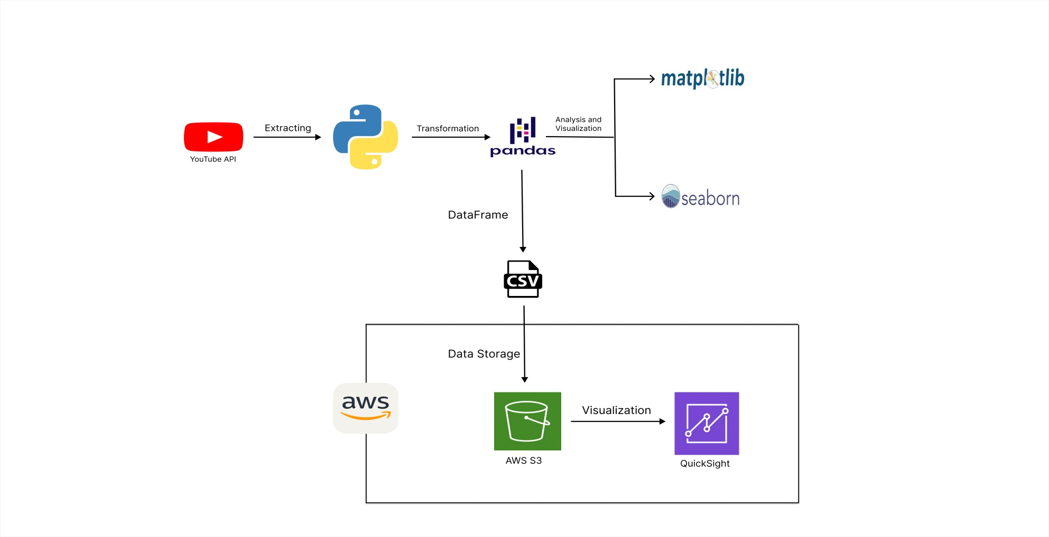
Architectural Diagrams
DD – MM - YYYY

Slide 9
Project Framework (Hardware / Software)
Hardware:
Intel i7 Processor
16GB RAM
Software:
Python, Pandas, NumPy for data analysis
Seaborn, Matplotlib for small-scale visualizations
AWS S3, QuickSight for large-scale data storage and visualization
DD – MM - YYYY

Slide 10
Modules (Explanation of Architectural Diagrams)
Data Collection Module: Utilizes YouTube API for fetching video metrics and comments.
Data Processing Module: Cleans and preprocesses data using Pandas.
Analysis Module: Employs Seaborn and Matplotlib for small data and AWS QuickSight for large data visualizations.
Storage and Visualization Module: Uses AWS S3 for data storage and QuickSight for interactive dashboards.
DD – MM - YYYY

Slide 11
Algorithm Used
Data Analysis: Pandas for preprocessing, Seaborn, and Matplotlib for small dataset visualizations
.Data Storage: AWS S3 for storing large datasets.
Visualization: QuickSight for visualizing large datasets.
DD – MM - YYYY

Slide 12
Module Implementation
Data Collection: Implemented Python scripts to fetch data using the YouTube API,
Data Processing: Utilized Pandas for cleaning and normalizing data.
Analysis and Visualization: Applied Seaborn and Matplotlib for initial insights and AWS QuickSight for scalable visualizations.
Data Storage: Stored processed data in AWS S3 for secure and scalable storage.
DD – MM - YYYY

Slide 13
Conference Details
Note: Name of the conference, where your team will be presenting your research paper.
Conference Name:
Conference Date:
Conference Venue:
DD – MM - YYYY

Slide 14
Thank You !!!

